Slide 1
HELMET DETECTION
Edalet Mehreliyev

Slide 2
Steps
01
02
03
04
05
06
Business Problem
İmage Preparation
Model Setup and OpenCV Integration
Detection Implementation
Testing and Validation
Deployment and Monitoring

Slide 3
Business Problem
01

Slide 4



Problem and solution
Ensuring safety in environments where helmets are required, such as construction sites or industrial areas, is critical. Manually monitoring helmet compliance is labor-intensive and prone to human error. An automated helmet detection system can significantly enhance safety protocols by providing continuous and accurate monitoring.
Consider a system where security cameras are deployed on a construction site to check whether workers are wearing helmets in real time. The system analyzes the images of the workers and gives an immediate warning in cases where the helmet is not worn. The implementation of such a system can help significantly increase safety and increase labor productivity in construction and industrial areas.

Slide 5


Technologies used
Python programming language
OpenCV Library and YOLOv3 Model

Slide 6
İmage preparation
02

Slide 7

İmage preparation
Pre-processing: We clean the images, label them and prepare them for model training. In this process, we resize the images (up to 416*416), add Padding to the Image with OpenCV so that the image does not lose its effect, includes steps such as contrast and brightness adjustment..

Slide 8

Model Setup and OpenCV Integration
03

Slide 9
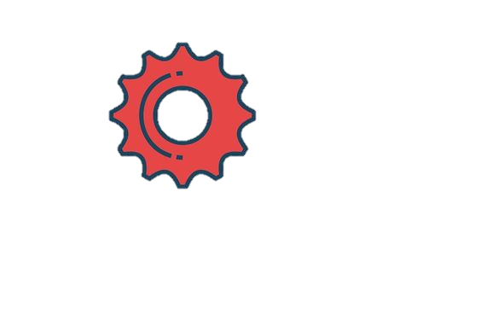

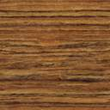
Model Setup and OpenCV Integration
We build the YOLOv3 model using predefined weights, a cfg file, and an adapted names file for helmet detection. This will ensure a robust and reliable detection process. Next, we integrate the YOLOv3 model with OpenCV to enable image processing and detection. The OpenCV library is widely used for image processing and analysis.

Slide 10

Detection Implementation
04

Slide 11
Detection Implementation
Develop the system to process images and video streams, applying the YOLOv3 model to detect helmets in real-time.
The system can detect helmets in different image formats and under different lighting and environmental conditions.
It provides automatic helmet detection when new images are entered into the system.

Slide 12

Testing and Validation
05

Slide 13
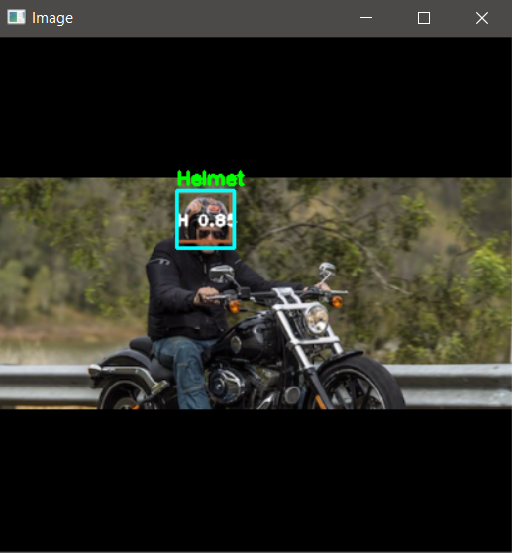
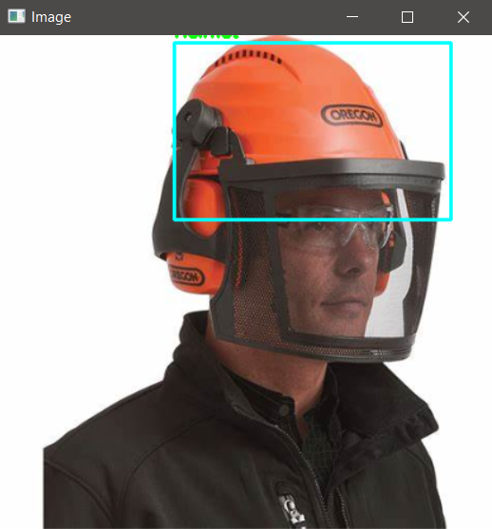
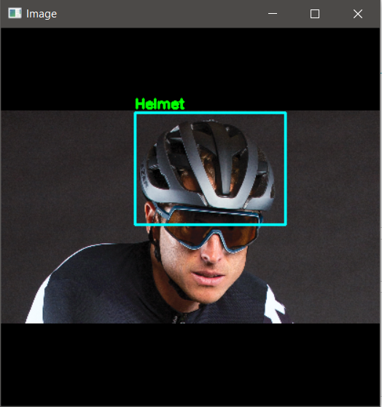
Testing and Validation
We test the system in different operating conditions and image qualities. And we make optimizations to increase the accuracy and speed of the results.

Slide 14

Deployment and Monitoring
06

Slide 15
We deploy the system. If a helmet is worn, it detects the helmet and displays the "helmet worn" message. Otherwise it says "helmet not worn".

Slide 16
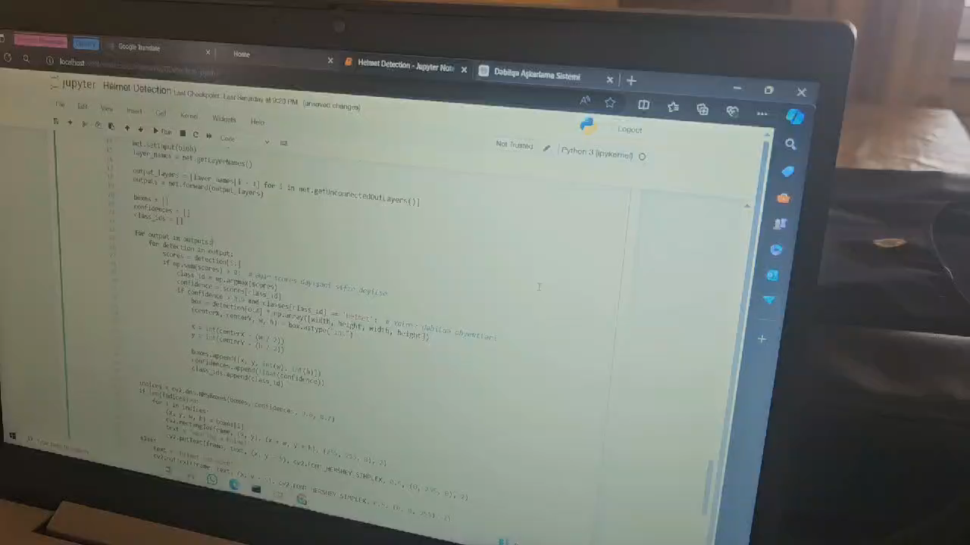

Slide 17
Thanks for your attention!

